Slide 1

CREDIT CARD LEAD PREDICTION By-Arpit Kulshrestha

Slide 2
Problem Introduction:
Problem: Happy Customer Bank is a mid-sized private bank that deals in all kinds of banking products, like Savings accounts, Current accounts, investment products, credit products, among other offerings.
The bank also cross-sells products to its existing customers and to do so they use different kinds of communication like tele-calling, e-mails, recommendations on net banking, mobile banking, etc.
In this case, the Happy Customer Bank wants to cross sell its credit cards to its existing customers. The bank has identified a set of customers that are eligible for taking these credit cards.
Bank wants to identify customers that could show higher intent towards a recommended credit card, given:
Customer details (Gender, Age, Region etc.)
Details of his/her relationship with the bank (Channel_Code,Vintage, Avg_Asset_Value etc.)
:Value Addition: We aim at building a model for the prediction of customers that could show a higher intent towards a recommended credit card.

Slide 3
Details of Problem:
Train Data has 11 features and 245725 observations
Test Data has 10 Features and 105312 observations.
Combined Data has 10 Features and 351037 observations.
Checking of Missing values.
Imputation Techniques using value “None” for filling the unknown/invalid category in gender.
Final categorisation of columns :
Categorical Attributes - 7 Attributes in total - 'ID', 'Gender', 'Region_Code', 'Occupation’, 'Channel_Code', 'Credit_Product', 'Is_Active’.
Quantitative Attributes – 3 Attributes in total -'Age', 'Vintage', 'Avg_Account_Balance’.
Target Feature Is_Lead.

Slide 4

Proposed Methodology
Understanding the Data Related to credit card lead prediction
Comparative
Evaluation
Merging the test and train data into one data frame
Improving the
Base Model
Data
Preprocessing
Exploratory
Data
Analysis
Base Model
Evaluation
Statistical
Test

Slide 5
Data Pre-processing Steps
Scaling and Encoding Feature Values
Imputation of Null values by ‘None’
Doing Univariate,Bivariate and Multivariate analysis
Dropping ‘ID’ feature for further analysis

Slide 6
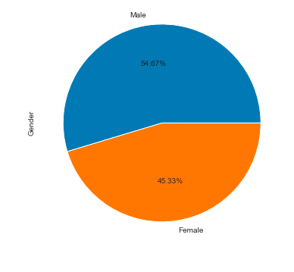
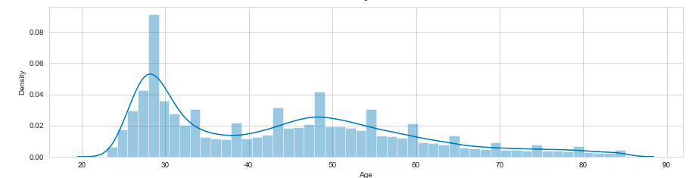
Project analysis slide 8
Data Visualization
Univariate Analysis
Countplot for ‘Gender’ variable
Dist. Plot of ‘Age’ variable
Observation: More Male customers are present in the dataset.
Observation: Age Is Rightly skewed.

Slide 7
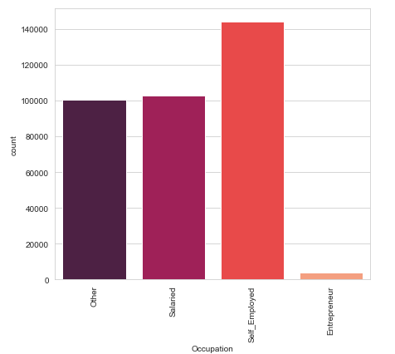
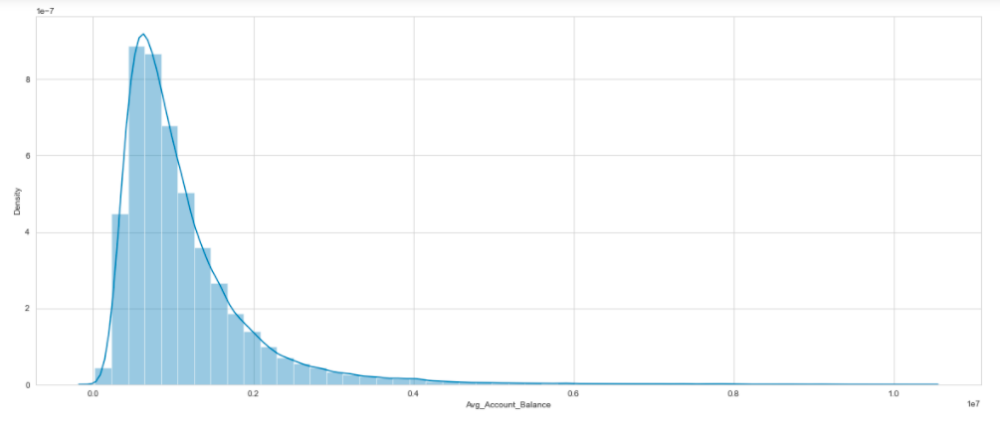
Project analysis slide 8
Data Visualization
Univariate Analysis
Bar plot for ‘Occupation’ variable
Dist. Plot of ‘Avg_Account_Balance’ variable
Observation: More Self_employed customers are there in dataset ,entrepreneurs are mostly not our customers
Observation: Avg_Account_Balance Is Rightly skewed.

Slide 8
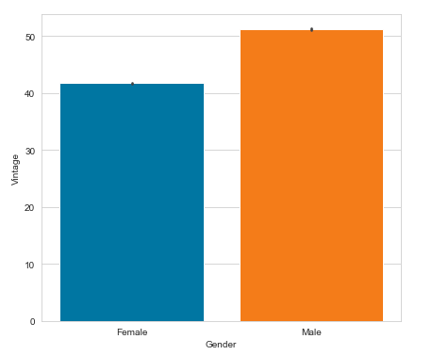
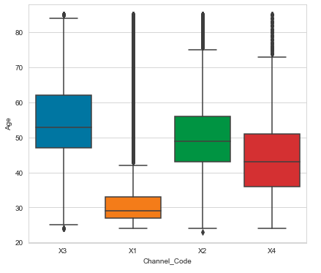
Project analysis slide 8
Data Visualization
Bi-variate Analysis
Bar plot for ‘Vintage’ vs ‘Gender’
Box Plot for ‘Age’ vs ‘Channel-Code’
Observation: Vintage for males has average 50 and for females has average 40
Observation: Median age of X3 is highest and lowest for X1 and X1 have heavy outliers.

Slide 9
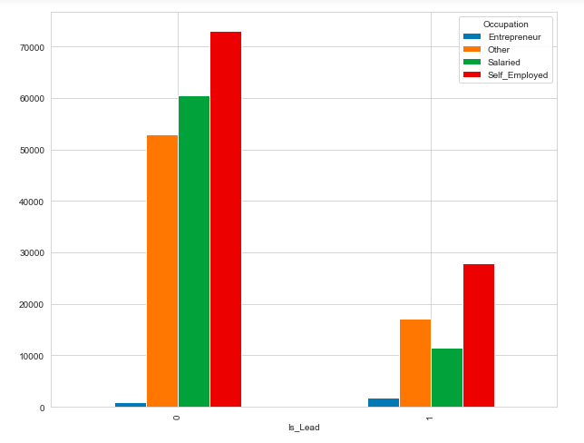
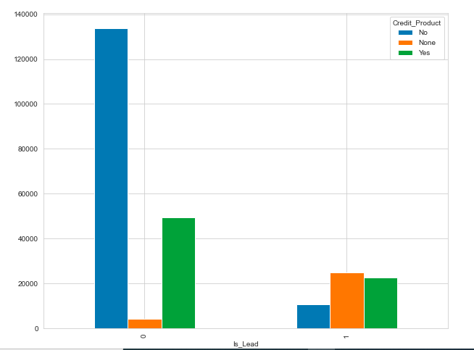
Project analysis slide 8
Data Visualization
Bi-variate Analysis
Bar plot for ‘Occupation’ vs ‘Is_Lead’
Bar Plot for ‘Credit_Product’ vs ‘Is_Lead’
Observation: Self-employed are more for both interested and non-interested customers
Observation: For non-interested customers, there are more customers with no credit product and for interested customers there are more with credit products

Slide 10
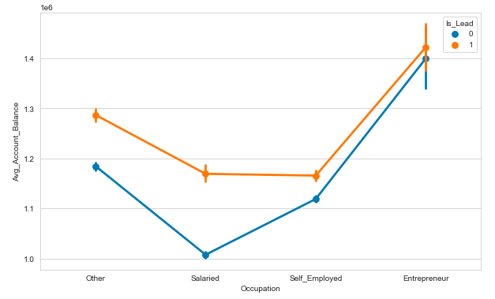
Project analysis slide 8
Data Visualization
Multi-variate Analysis
Point plot for ‘Occupation’ vs ‘Avg_Account_Balance’ vs ‘Is_Lead’
Observation: Mean Avg_Account_Balance for interested and non-interested customers is highest for Entrepreneurs while for non-interested customers it is lowest for Salaried class.

Slide 11




Project analysis slide 8
CV Scores
XgBoost
Random Forest
LGBM
CatBoost

Slide 12
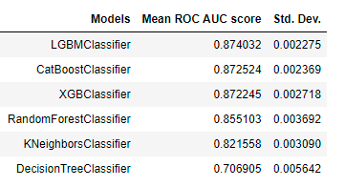
Project analysis slide 8
CV Score Table
Observation: Based on CV score XGBoost,LGBM are selected for further Calculation.

Slide 13
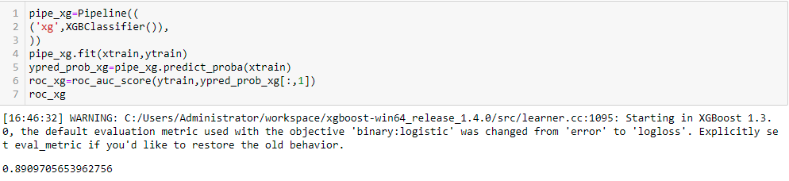
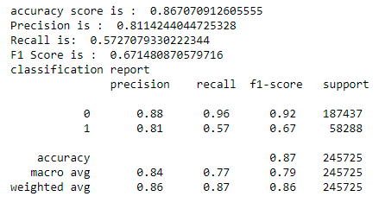
Project analysis slide 10
XGB Classifier
Base model of XGB is giving ~0.89 roc_auc_score on train dataset.
Accuracy score is ~0.86.
Also printed classification report.
The Recall for class 1 is coming low,i.e.,False Negative are high for this class.

Slide 14
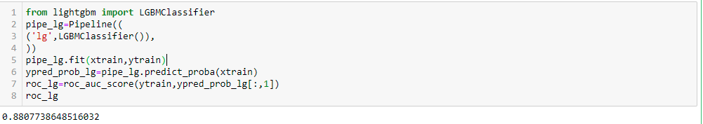
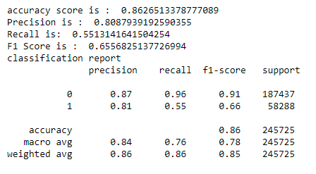
Project analysis slide 10
LGBM Classifier
Base model of LGBM is giving ~0.88 roc_auc_score on train dataset.
Accuracy score is ~0.86.
Also printed classification report.
The Recall for class 1 is coming low,i.e.,False Negative are high for this class.

Slide 15
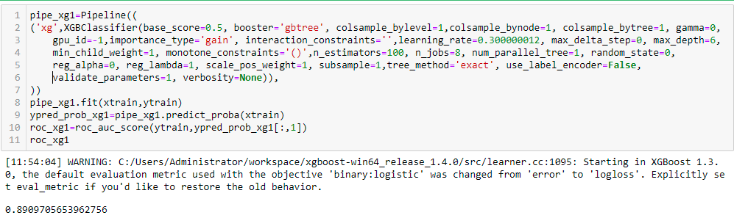
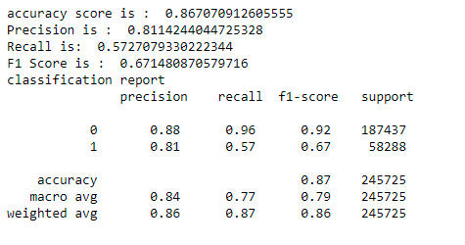
Project analysis slide 10
XG Boost Classifier with K Fold Split
XGB classifier modelling along with K cross-validation of 10 folds is done.
Accuracy score is ~0.87.
ROC score of train set is ~0.8909.
ROC score of test set is ~0.8733.
Oversampling Reducing the test Roc Score to ~0.868

Slide 16
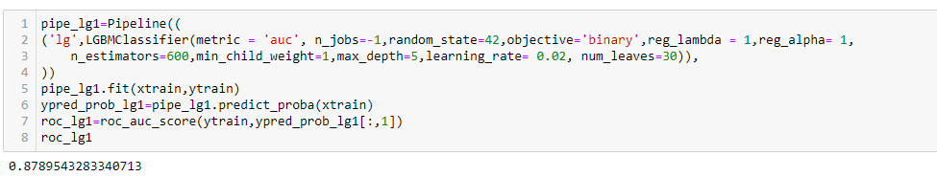
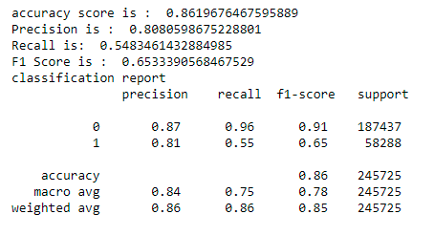
Project analysis slide 10
LGBM Classifier with K Fold Split
LGBM classifier modelling along with K cross-validation of 10 folds is done.
This was done to remove any overfitting issues in the model.
ROC score of train set is ~0.8789.
ROC score of test set is ~0.8729

Slide 17
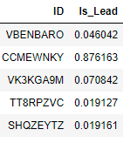
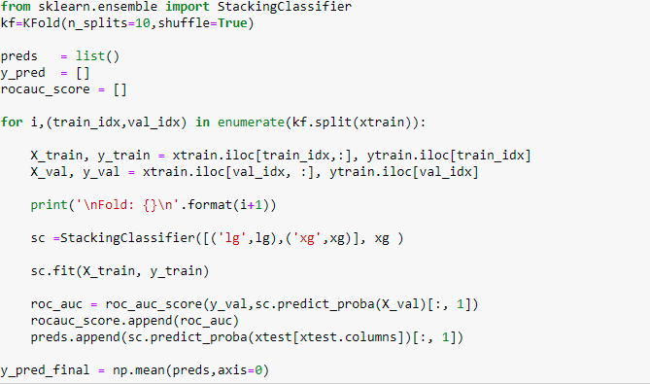
Project analysis slide 10
Final Model – Stacking(XGB and LGBM)
Final Prediction was made using Stacking model against test data where XG Boost and LGBM are base estimators and XGB is Final Estimator.
Following AUC score was observed:
XG Boost – 0.8733
LGBM – 0.8729
Stacking-0.8738
Final predictions with Stacking is chosen and predictions saved to csv file

Slide 18
Conclusion
Data has 10 Features and 351037 observations and has both categorical and numerical data. Categorical data is labelled for EDA analysis.
Data-Preprocessing and EDA is also been done:
Target Variable is imbalanced and needed to be corrected for proper modelling.
More Self_employed customers are there in dataset ,entrepreneurs are mostly not our customers.
For non-interested customers, there are more customers with no credit product and for interested customers there are more with credit products.
Mean Avg_Account_Balance for interested and non-interested customers is highest for Entrepreneurs while for non-interested customers it is lowest for Salaried class.
All Base Models are Build and After that CV scores are checked from there LGBM and XGBoost have been selected for further modelling.
Oversampling is also done but it didn’t improve the model.
LGBM Classifier with K-Fold Split:
LGBM model with 10-fold cross-validation was used and ROC AUC score 0.8789 with training data.
Model performed very well with test data and provided ROC AUC score of ~0.8729
XG Boost Classifier with K-Fold Split:
XG Boost method was used and ROC AUC score of ~0.8909 was found with the training data.
Model performed very well with test data and provided ROC AUC score of ~0.8733
Hence, final model is selected as Stacking model where both LGBM and XGB is chosen as base estimator and XGB is chosen as final estimator to give highest ROC AUC score.

Slide 19
Thank You

